Slide 1
Hyp. Online Store
(Store Analysis Report)
By: TATA DA Team

Slide 2
Todays Agenda
Project recap & Problem Defining
Process
Insights
Summary

Slide 3
Project Recap
Analyzing the transactional data provided by the store and answering the CEO and CMO’s query regarding the stores performance.
Q1: What is the Revenue trend over the time for the year 2011. (Monthly Revenue Chart)
Q2: Top 10 countries by Revenue. (Exc. United Kingdom)
Q3: Top 10 customers by Revenue.
Q4: Product popularity and demand by Region. (Exc. United Kingdom)

Slide 4

Process
1
Data Understanding
2
Data Cleaning
3
Data Preparation for Analysis
4
Final Insights in BI tools

Slide 5
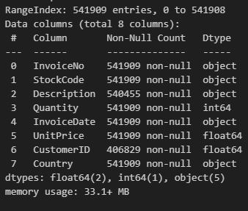
1. Data Understanding
Data was loaded on python for general Analysis.
541909
4372
Total Transactions
Total Customers
25900
5.17 M
Total Orders
Total Products Sold
38
Total Countries

Slide 6
2. Data Cleaning
Quantity < 1 removed
Unit Price < 0 removed

Slide 7
Insights

Slide 8
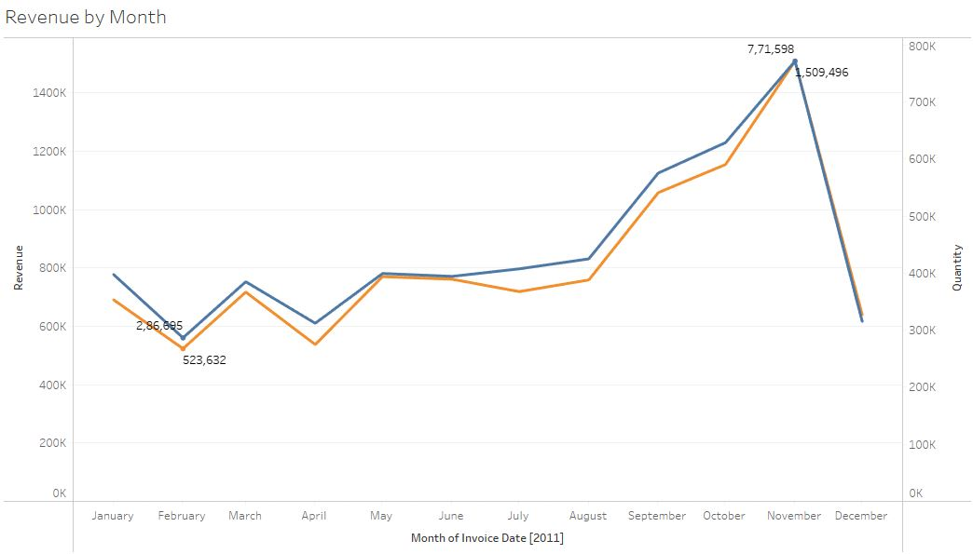
1. Revenue Over Time
Quantity Sold
Revenue

Slide 9
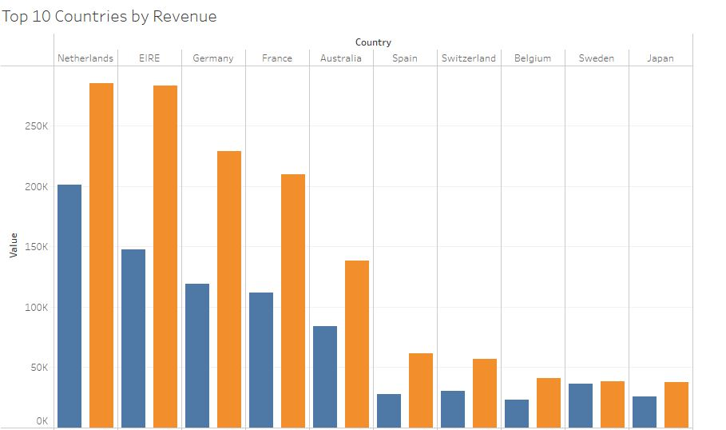
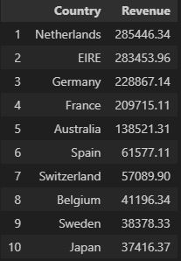
2. Top 10 Countries by Revenue
Excluding: United Kingdom
Quantity Sold
Revenue

Slide 10
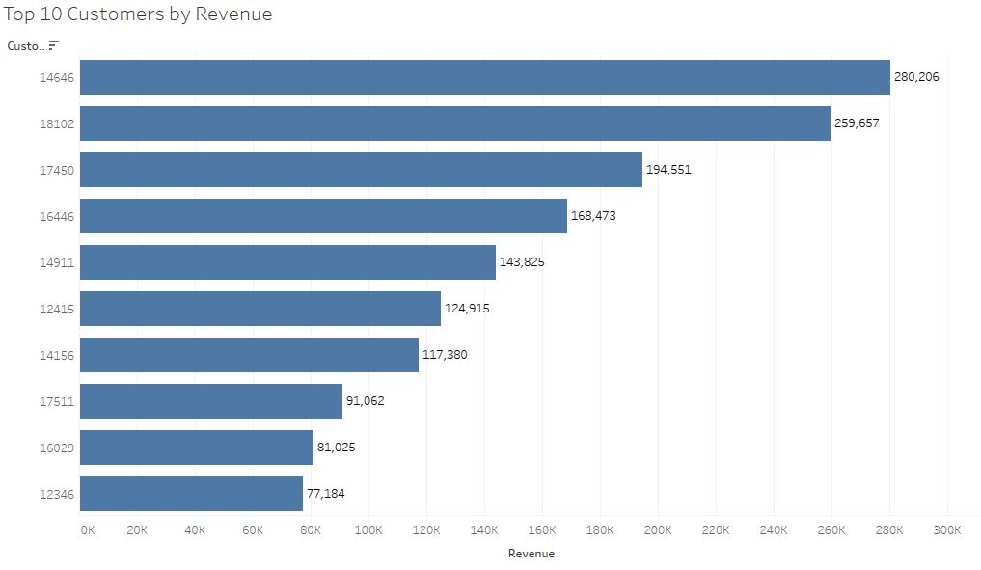
3. Top 10 Customers by Revenue

Slide 11
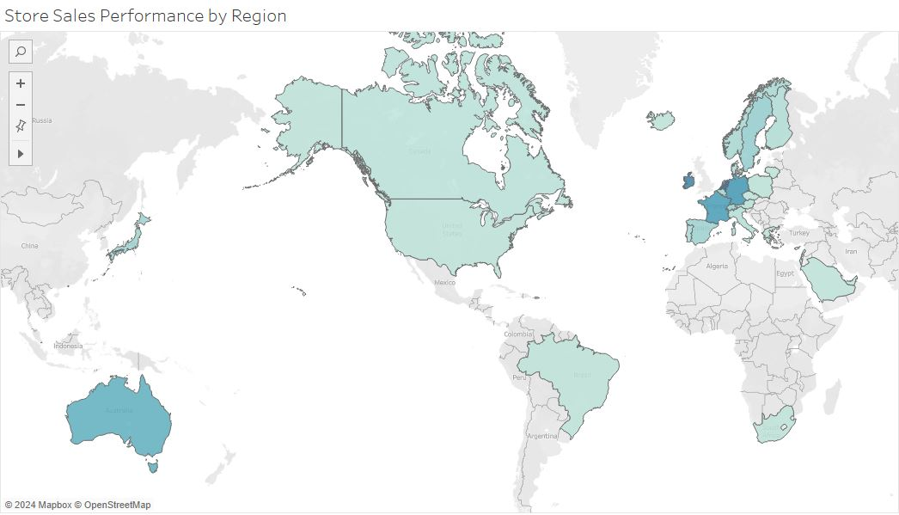
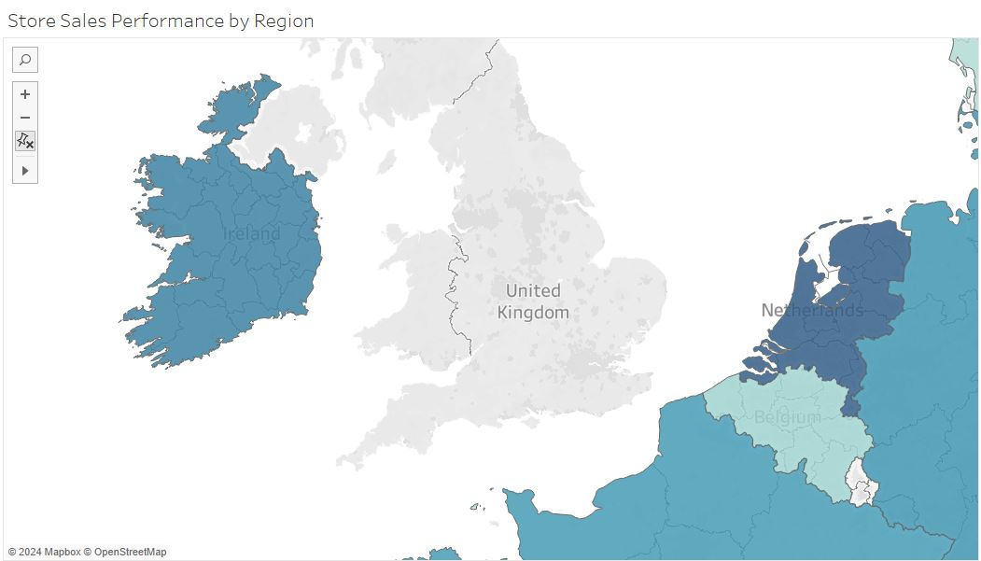
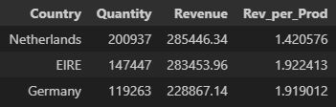
4. Demands by Region

Slide 12
Summary
The Revenue is driven by the quantity of orders.
9/10 top 10 customers by revenue have made transaction more than once.
20% of your products lineup are driving 80% of the store’s revenue
Ireland & Germany spends per quantity more than Netherland which is the top revenue region, excl. United Kingdom.
Netherland: 1.42, Ireland: 1.92, Germany: 1.91

